Slide 1
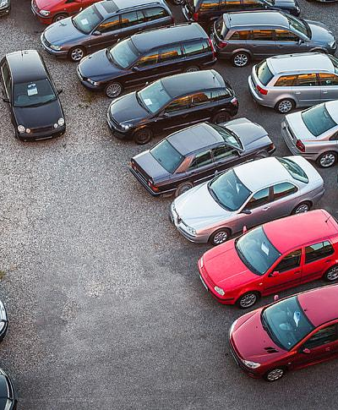
Used Car Price Prediction
By: Patricia Miranda

Slide 2
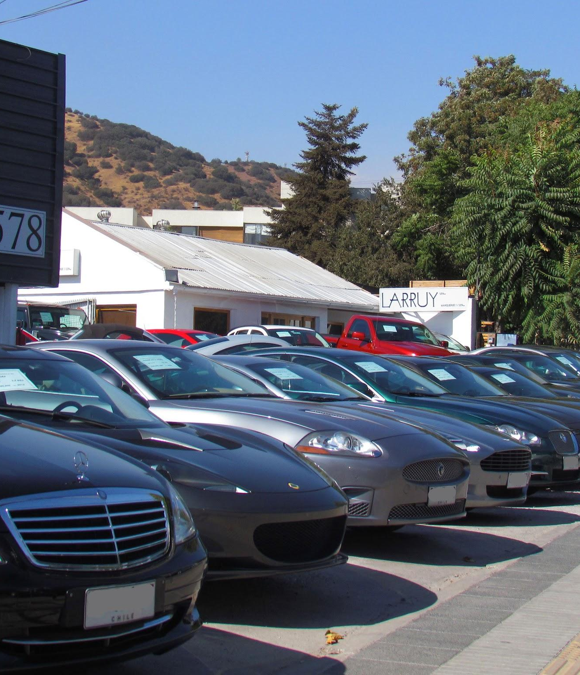
The Problem:
How to predict the prices of used cars in today’s economy?

Slide 3
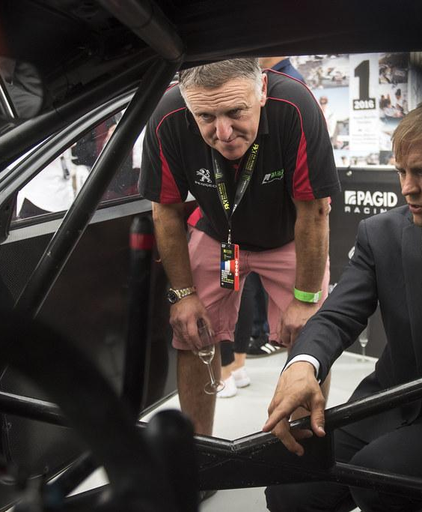
The Solution:
Identify determining factors for predicting the prices of used cars for 2024 and onwards with predictive models.

Slide 4
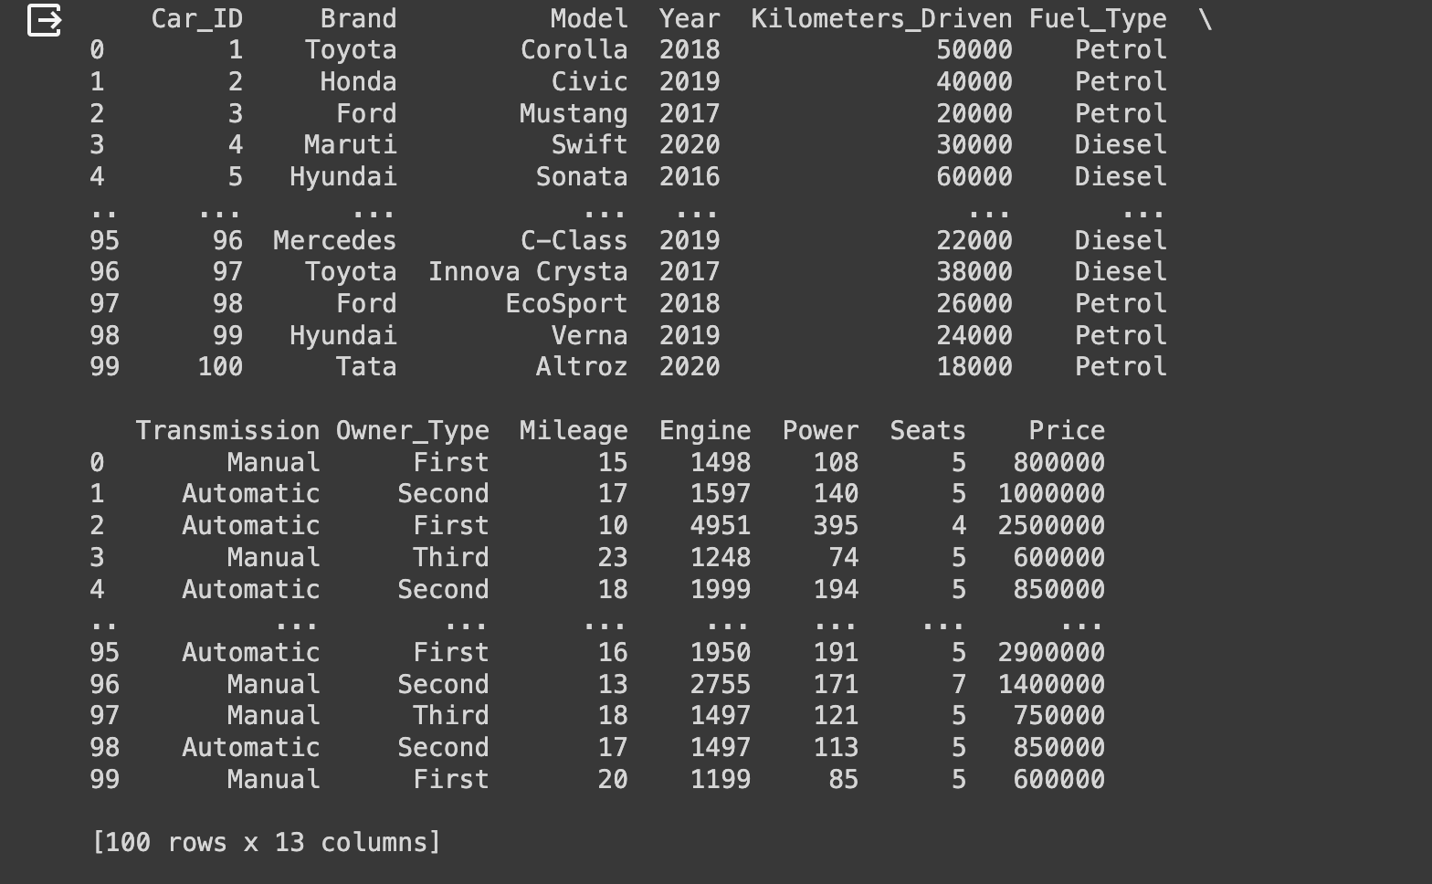
The Dataset:
Used Car Data:

Slide 5



Data Wrangling
Analyze data types and identify missing values
Drop rows with null values in all columns [Mileage, Fuel Type]
Target value: ‘Prices’

Slide 6
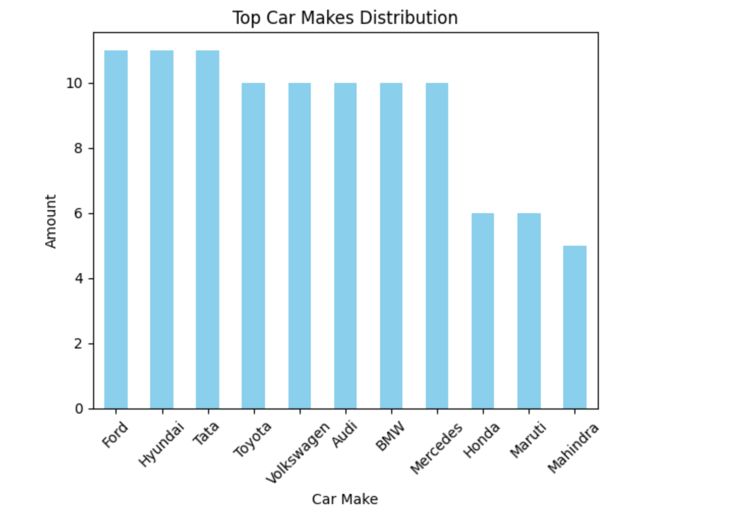
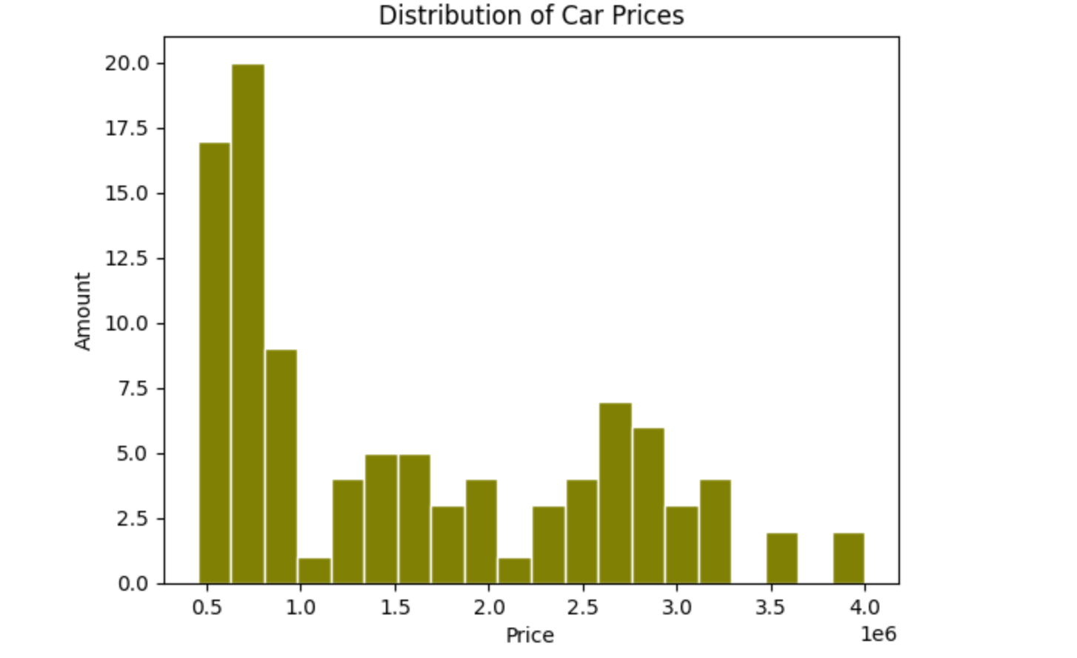
Exploratory Data Analysis:

Slide 7


Takeaways:
RandomForestClassifier was the most accurate model
Most features are not important (Only used certain columns for analysis)

Slide 8

Future Analysis:
Use more data from different car sale sources, specifically ones in US markets
Use other models for prediction
Obtain/use more recent datasets

Slide 9
Questions?

